Slide 1
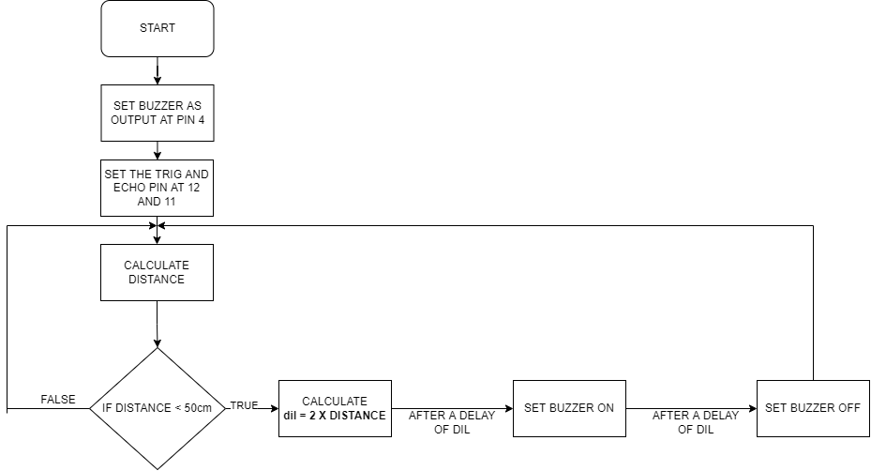
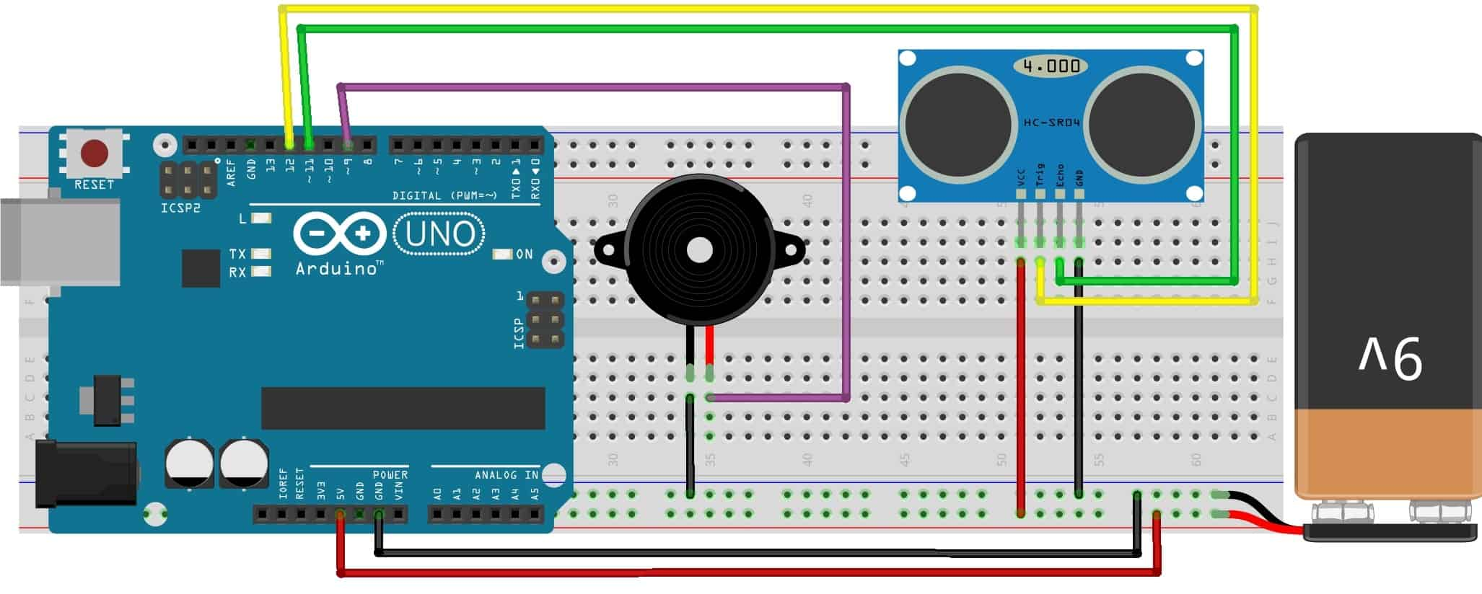
BLIND WALKING SMART STICK
By Suleman Shah(21PWCSE1983),Shahzad Bangash(21PWCSE1980),Ali Asghar
ABSTRACT
COMPONENTS USED
CONCLUSIONS
Blind Walking Smart Stick helps the blind and visually impaired persons. In this modern era of technology, almost every person is at risk of losing his eye sight. The number of blind persons is increasing day by day. To solve this issue, we have come up with the idea of Blind Walking Smart Stick. It is an effort to lessen the issues faced by blind persons during walk. This project makes use of Arduino and Ultrasonic sensor for detecting obstacles in the path of blind person. The signal is received by Ultrasonic Sensor in a certain range and then the output is shown in the beep of a buzzer. The whole above logic is implemented in a stick.
Arduino UNO Board
HC-SR04 Ultrasonic Sensor
Buzzer
9 Volt Battery
Stick
Connecting Wires
We can use Ultrasonic Sensor (in association with Arduino) for smart object detections. This idea can be utilized in many ways for the welfare of Human Society. Blind Walking Smart Stick is just a small step in this movement for welfare of Human Society. There’s still a lot to achieve and great ideas are yet to come.
CIRCUIT CONNECTIONS
Vcc pin of HC-SR04 is connected to 5 volt pin of Arduino
Trigger pin of HC-SR04 is connected to D12 pin of Arduino
Echo pin of HC-SR04 is connected to D11 pin of Arduino
The ground of HC-SR04 is connected to the GND pin of Arduino.
A buzzer is connected between the D4 pin of Arduino and the GND pin.
MAIN OBJECTIVES
REFERENCES
To aid the blind people in their life, specifically during walking.
To help the blind people in visualizing the world around them.
https://www.freepptbackgrounds.net/business-finance/light-blue-lines-powerpoint-backgrounds
https://www.cleanpng.com/png-arduino-uno-atmega328-single-board-microcontroller-2942625/
https://www.typewolf.com/austin
https://www.flaticon.com/premium-icon/motherboard_5921800
https://www.flaticon.com/free-icon/buzzer_5387095
https://how2electronics.com/blind-walking-stick-arduino-ultrasonic-sensor/
https://www.flaticon.com/free-icons/electronic
INTRODUCTION
FLOW CHART OF ARDUINO CODE
Almost 39 million people are blind according to the recent WHO Report. These blind people are totally dependent on others as they can’t walk alone. This is the reason why we have designed the Blind Walking Smart Stick device which will help blind people to walk with ease independently.
CIRCUIT DIAGRAM

